Slide 1



*AMARETTO for network biology and medicine: linking diseases, drivers, targets and drugs via multi-omics, clinical, imaging and perturbation data fusion
Nathalie Pochet, Ph.D.
Assistant Professor, Harvard Medical School Associate Scientist, Brigham and Women’s Hospital Associate Member, Broad Institute of MIT and Harvard
http://portals.broadinstitute.org/pochetlab/
http://portals.broadinstitute.org/pochetlab/amaretto.html
npochet@broadinstitute.org, npochet@bwh.harvard.edu
Funded by NIH NCI ITCR
Notes:
I want to introduce you to the *AMARETTO software tools for network biology and medicine,
That facilitate linking diseases, drivers, targets and drugs via fusion of multi-omics, clinical, imaging and perturbation data.
---
We present *AMARETTO as a software toolbox for network biology and medicine, towards developing a data-driven platform for diagnostic, prognostic and therapeutic decision-making in cancer. The *AMARETTO platform offers modular and complementary solutions to multimodal and multiscale network-based fusion of multi-omics, clinical, imaging, and driver and drug perturbation data across studies of patients, etiologies and model systems of cancer. Specifically: (1) The AMARETTO algorithm learns networks of regulatory circuits - circuits of drivers and target genes - from functional genomics or multi-omics data and associates these circuits to clinical, molecular and imaging-derived phenotypes within each biological system (e.g., model systems or patients); (2) The Community-AMARETTO algorithm learns subnetworks of regulatory circuits that are shared or distinct across networks derived from multiple biological systems (e.g., model systems and patients, cohorts and individuals, diseases and etiologies, in vitro and in vivo systems); (3) The Perturbation-AMARETTO algorithm maps genetic and chemical perturbations in model systems onto patient-derived networks for driver and drug discovery, respectively, and prioritizes lead drivers, targets and drugs for follow-up with experimental validation; and (4) The Imaging-AMARETTO algorithm maps radiography and histopathology imaging data onto the patient-derived multi-omics networks for imaging diagnostics.
For several Use Cases, we demonstrate the utility of *AMARETTO via R Jupyter Notebook workflows that run the Bioconductor and GitHub repositories on Google Colaboratory, accompanied by HTML reports that embed Shiny and Neo4j interactive representations of results. Specifically, these Use Cases integrate multi-omics, clinical, imaging, and driver and drug perturbation data across studies of patients, etiologies and model systems of cancer: (1) A study of hepatitis C and B virus-induced hepatocellular carcinoma (LIHC) with driver and drug discovery for chemoprevention across etiologies of LIHC, experimentally validated in rat models; (2) A study of glioblastoma multiforme (GBM) and low-grade glioma (LGG) with driver discovery for diagnostic and prognostic molecular subnetworks associated with radiography and histopathology imaging features for imaging diagnostics; and (3) A pan-cancer study of squamous cell carcinoma (SCC) across five SCC cancer sites, in particular, lung (LUSC), head and neck (HNSC), esophageal (ESCA), cervical (CESC) and bladder (BLCA).
https://bioconductor.org/packages/release/bioc/html/AMARETTO.html

Slide 2
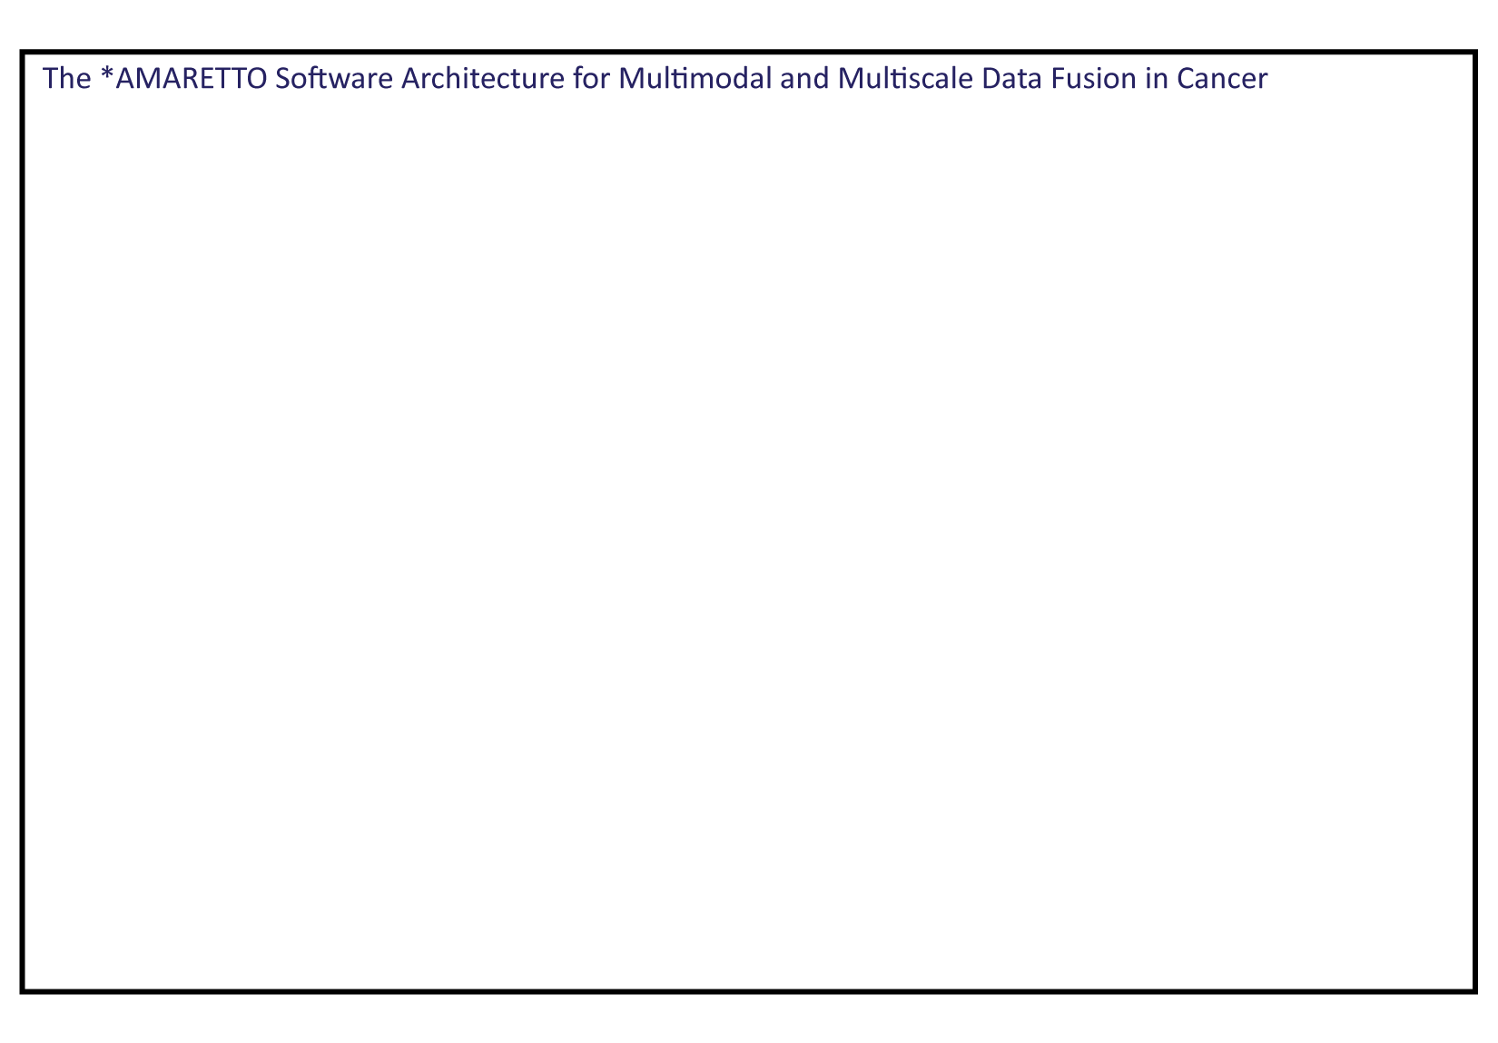
Notes:
With more and more data becoming available in biomedicine, there is a need for methods that can systematically integrate multimodal and multiscale data levels in studies of complex disease, such as cancer.
And this is why we wanted to develop the AMARETTO framework that consists of several algorithms that each take care of complementary aspects of the multimodal and multiscale data fusion.

Slide 3
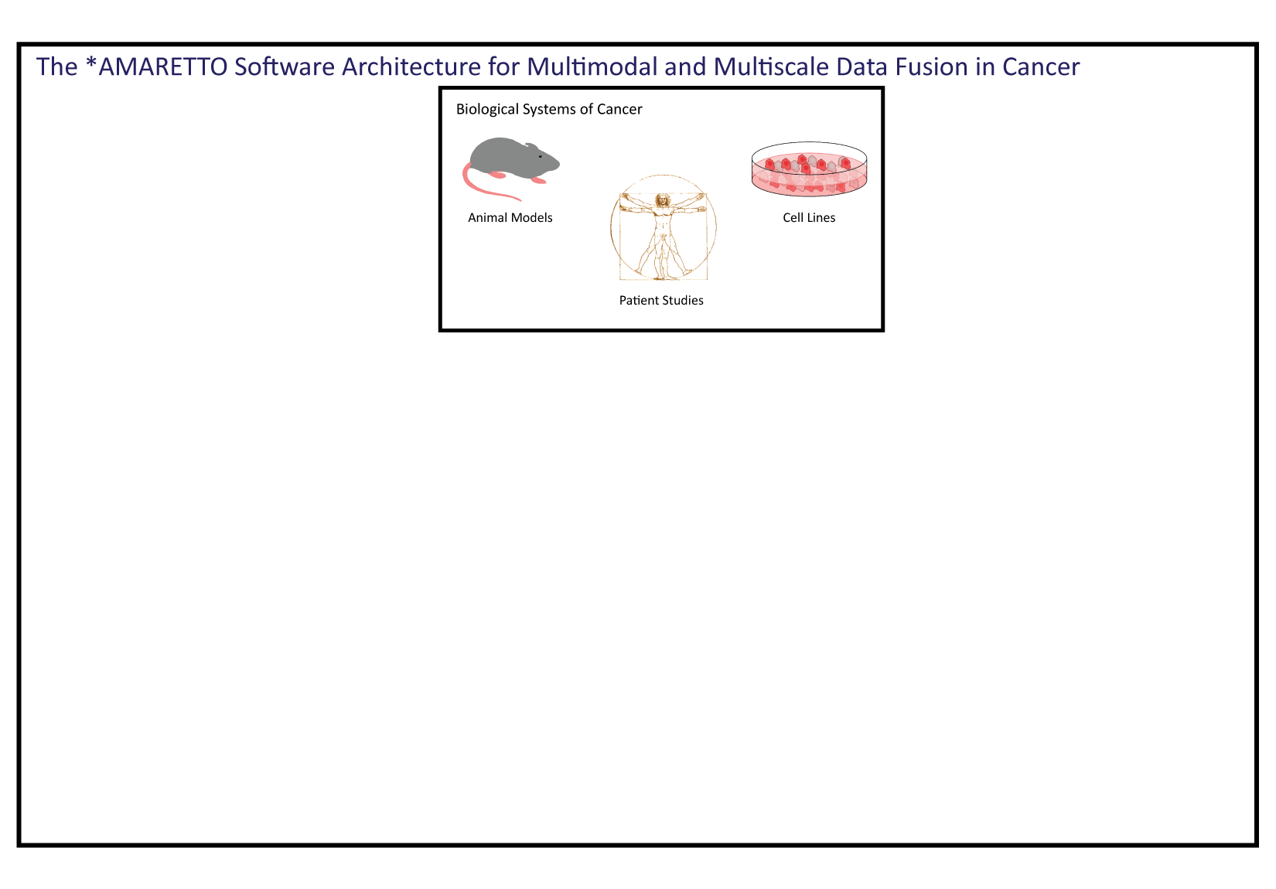
Notes:
Multiscale data can come from multiple biological systems of disease, such as studies of patients, etiologies and model systems such as cell lines and animal models, that each provide us with complementary insights into disease biology.

Slide 4
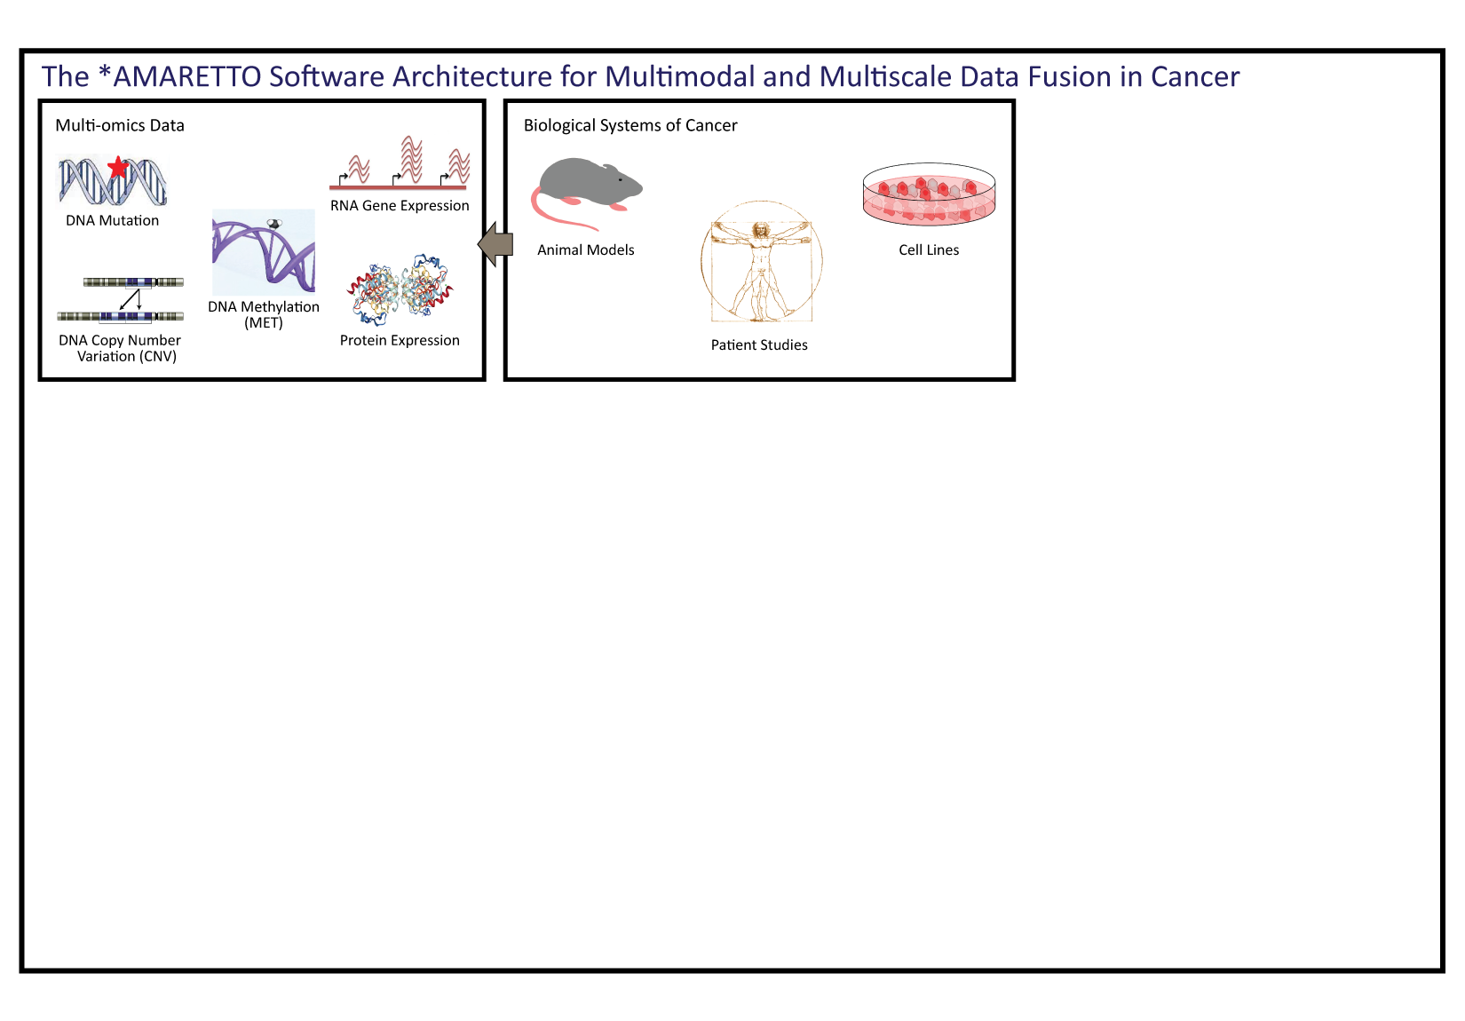
Notes:
For each of these biological systems, we typically have multimodal data levels, such as multi-omics, clinical and imaging data.
For example, for cancer, we have multi-omics data available from TCGA, including genetic, epigenetic, and functional genomics data such as transcriptomic and proteomic data.

Slide 5
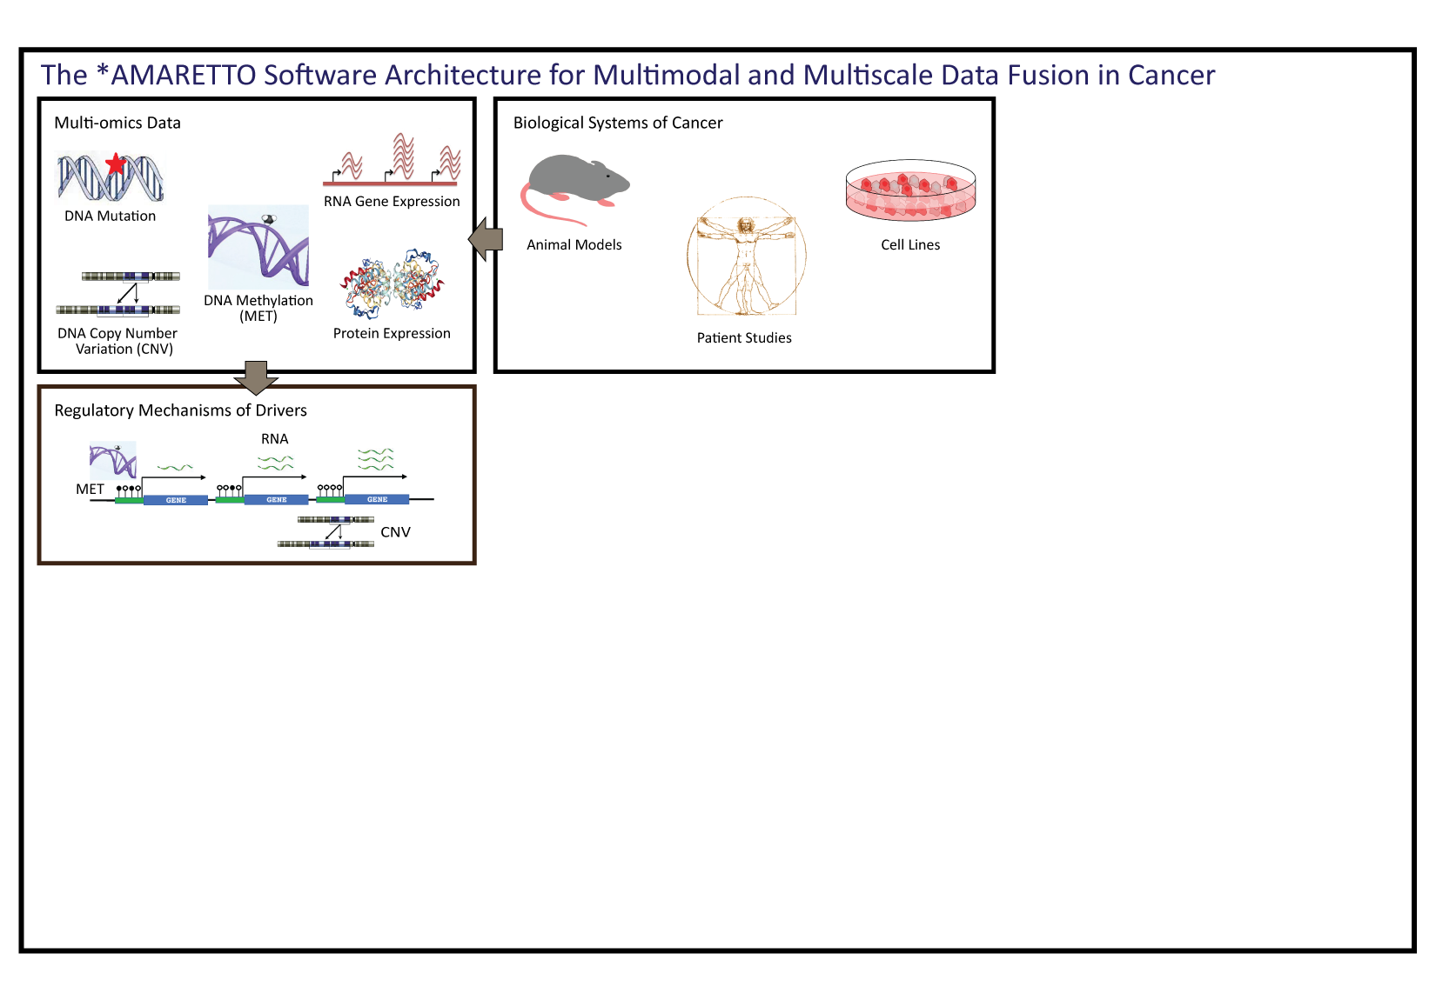
Notes:
The first core algorithm starts with upstream modeling of the cis-regulatory mechanisms of cancer drivers and variants from multi-omics data.
We identify somatic recurrent genetic and epigenetic variants that have a direct functional impact on their own gene expression.

Slide 6
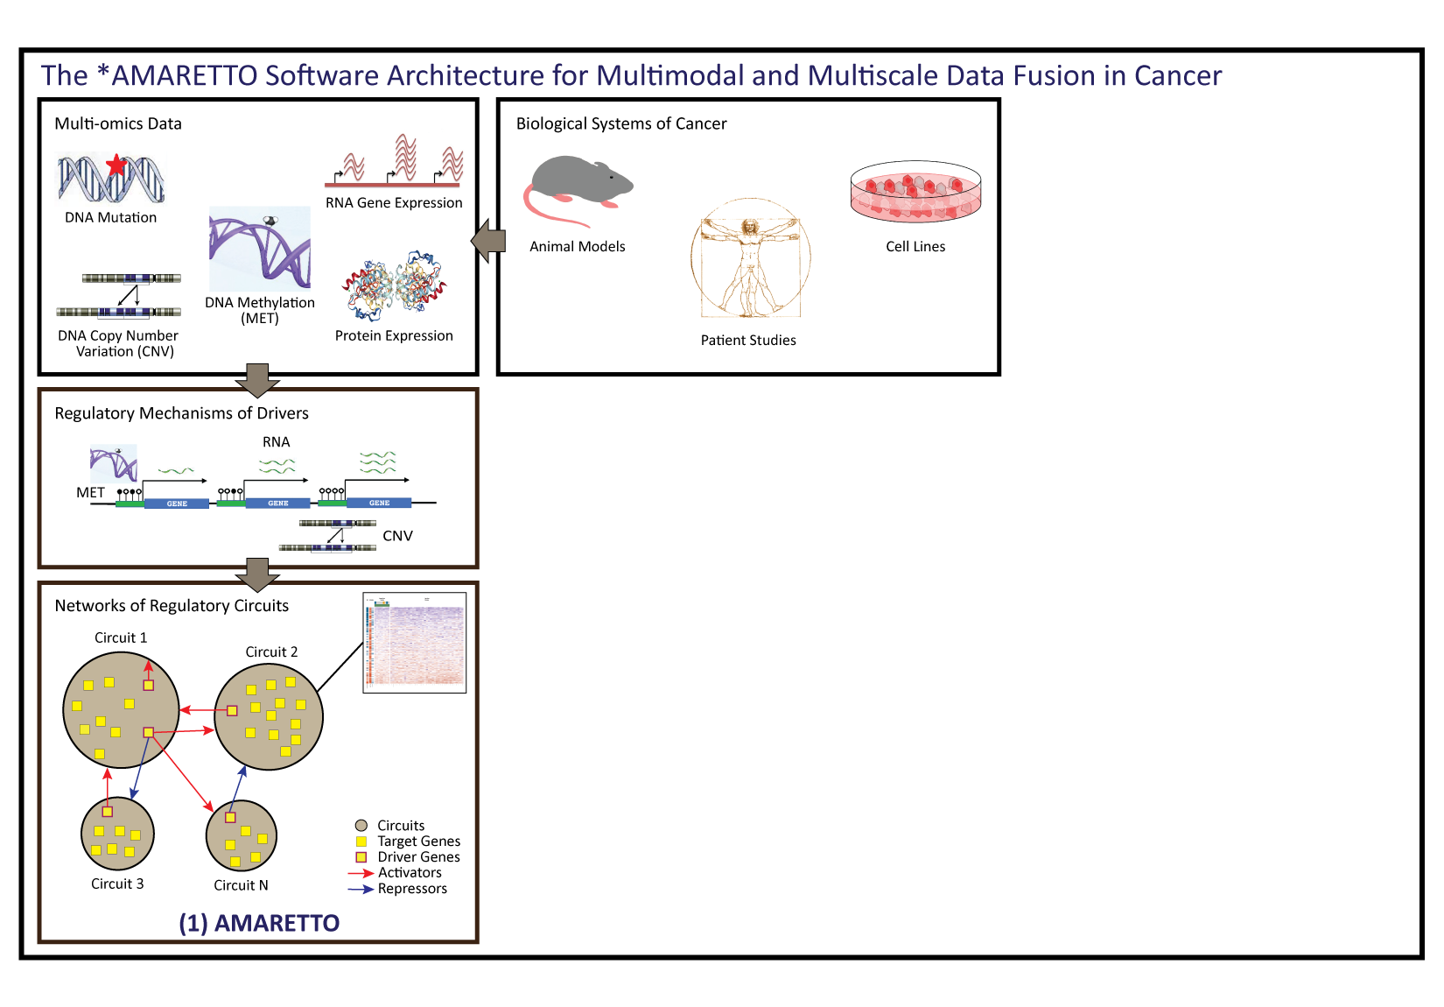
Notes:
These we interrogate for their regulatory potential in trans-regulatory networks that we learn from functional genomics data.
So this is the first core algorithm, which is the AMARETTO algorithm that learns networks of regulatory circuits - circuits of target genes and their shared drivers - within each biological system or cohort.

Slide 7
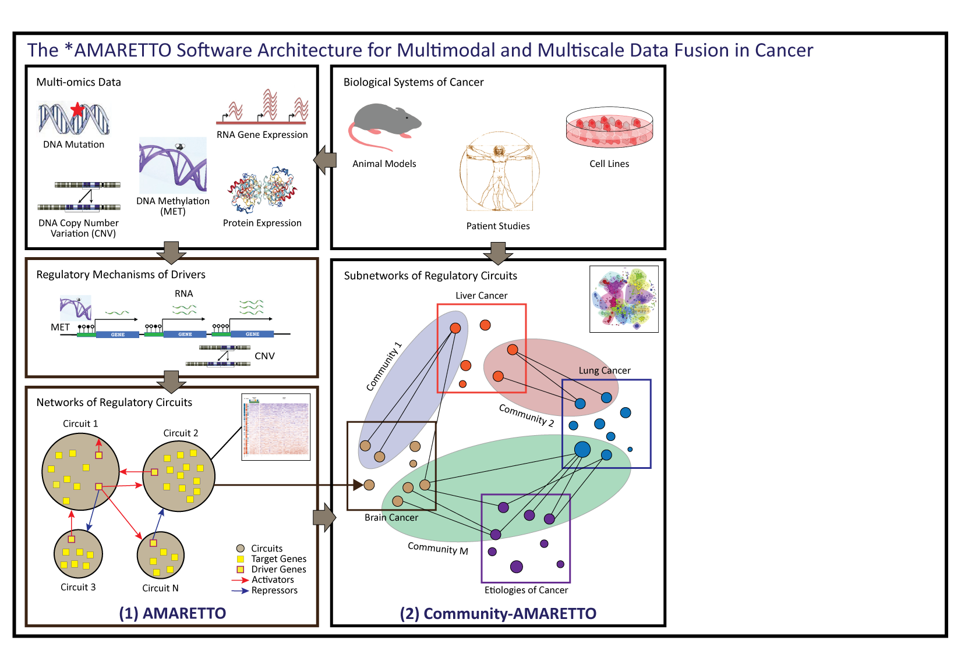
Notes:
Now we want to identify subnetworks or communities of regulatory circuits that are shared or distinct across multiple systems of disease, for example, to study multiple cancers and multiple etiologies of cancer.
For this, we developed the second core algorithm, which is the Community-AMARETTO algorithm that compares multiple AMARETTO networks derived from multiple biological systems, diseases or cohorts.

Slide 8
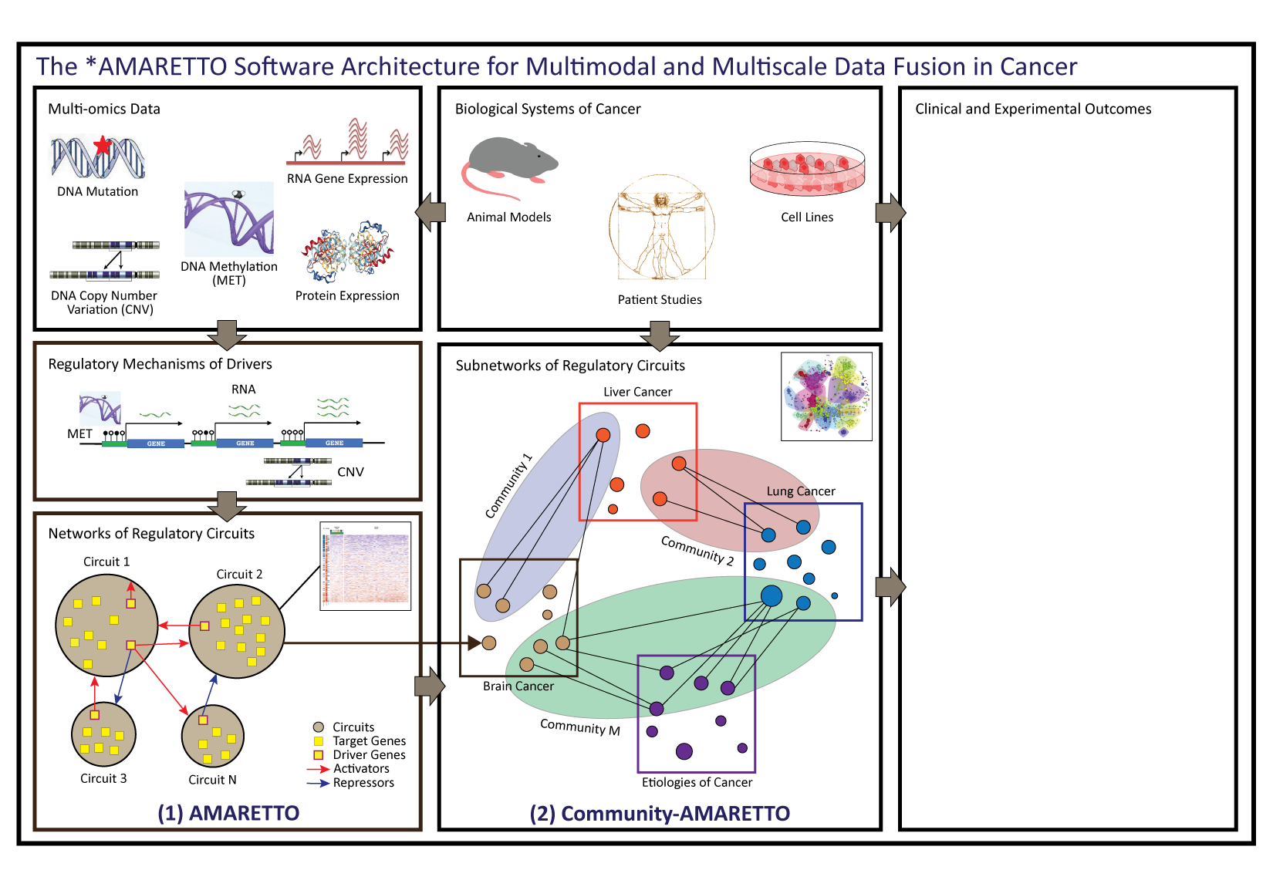
Notes:
And finally we provide downstream tools to interpret these networks and subnetworks of regulatory circuits for clinical and experimental outcomes.

Slide 9
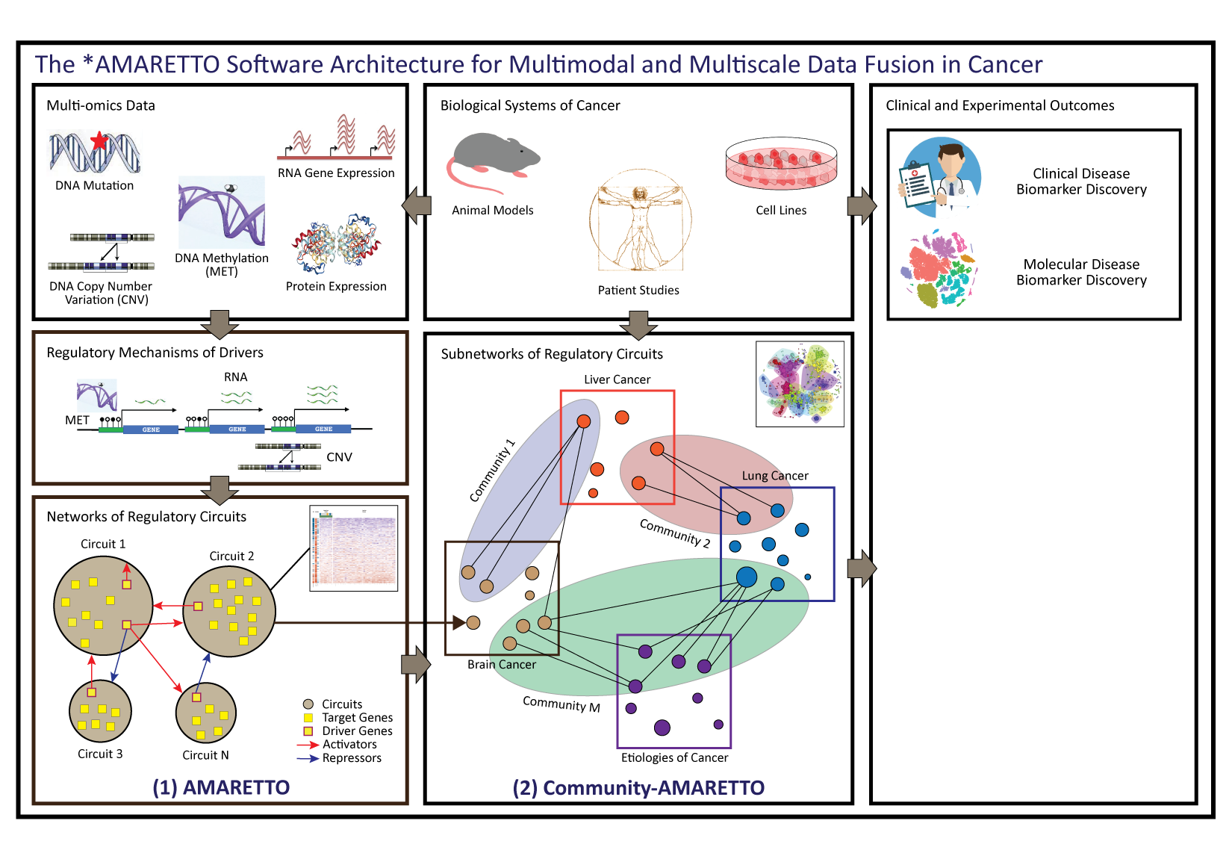
Notes:
For example, we assess them for their association to clinical and molecular features, such as survival and known mutations.

Slide 10
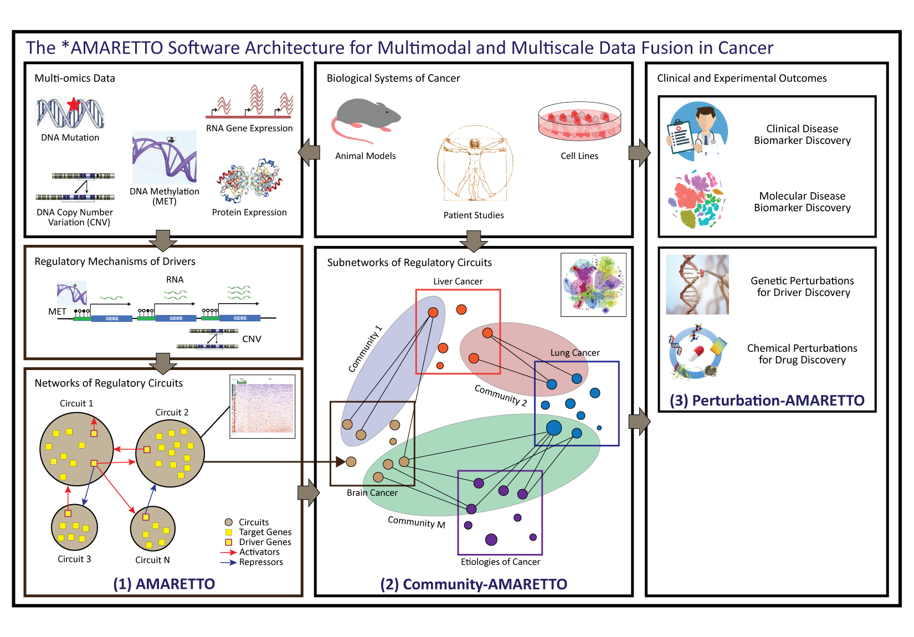
Notes:
We also assess them for how they are modulated by genetic and chemical perturbations in model systems, for driver and drug discovery. This is done by the Perturbation-AMARETTO algorithm.

Slide 11
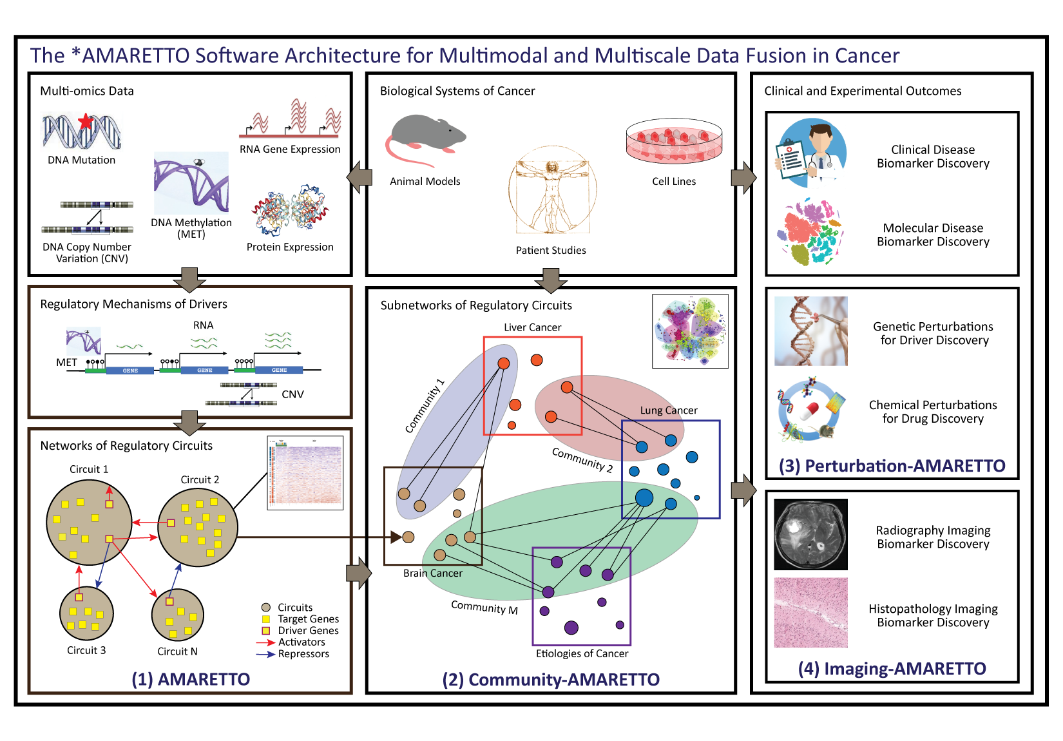
Notes:
And finally, we assess them for their association to radiography and histopathology imaging features, for imaging diagnostics. And this is done by the Imaging-AMARETTO algorithm.
So together, these algorithms allow us to ask complex questions in biomedicine, such as to discover drugs that can reverse drivers and their targets underlying complex disease.

Slide 12
Drug discovery:
Chemoprevention of hepatitis C and B virus-induced hepatocellular carcinoma
Notes:
For example, in our study of virus-induced liver cancer, we wanted to identify drugs for chemoprevention for hepatitis C and B virus-infected patients that are at greater risk of progressing to liver cancer.

Slide 13
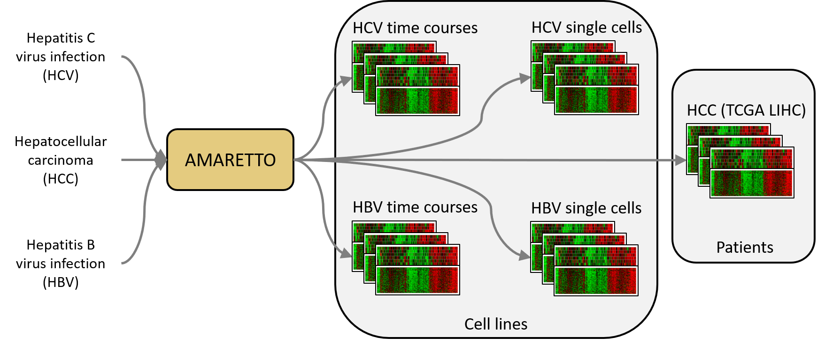
Drug discovery:
Chemoprevention of hepatitis C and B virus-induced hepatocellular carcinoma
Driver and drug discovery
for hepatitis C (HCV) and hepatitis B (HBV)
virus-induced hepatocellular carcinoma (HCC)
Notes:
We studied the liver cancer patient cohort from TCGA together with more in-depth studies of the host responses to hepatitis C and B virus infection in cell line models.

Slide 14
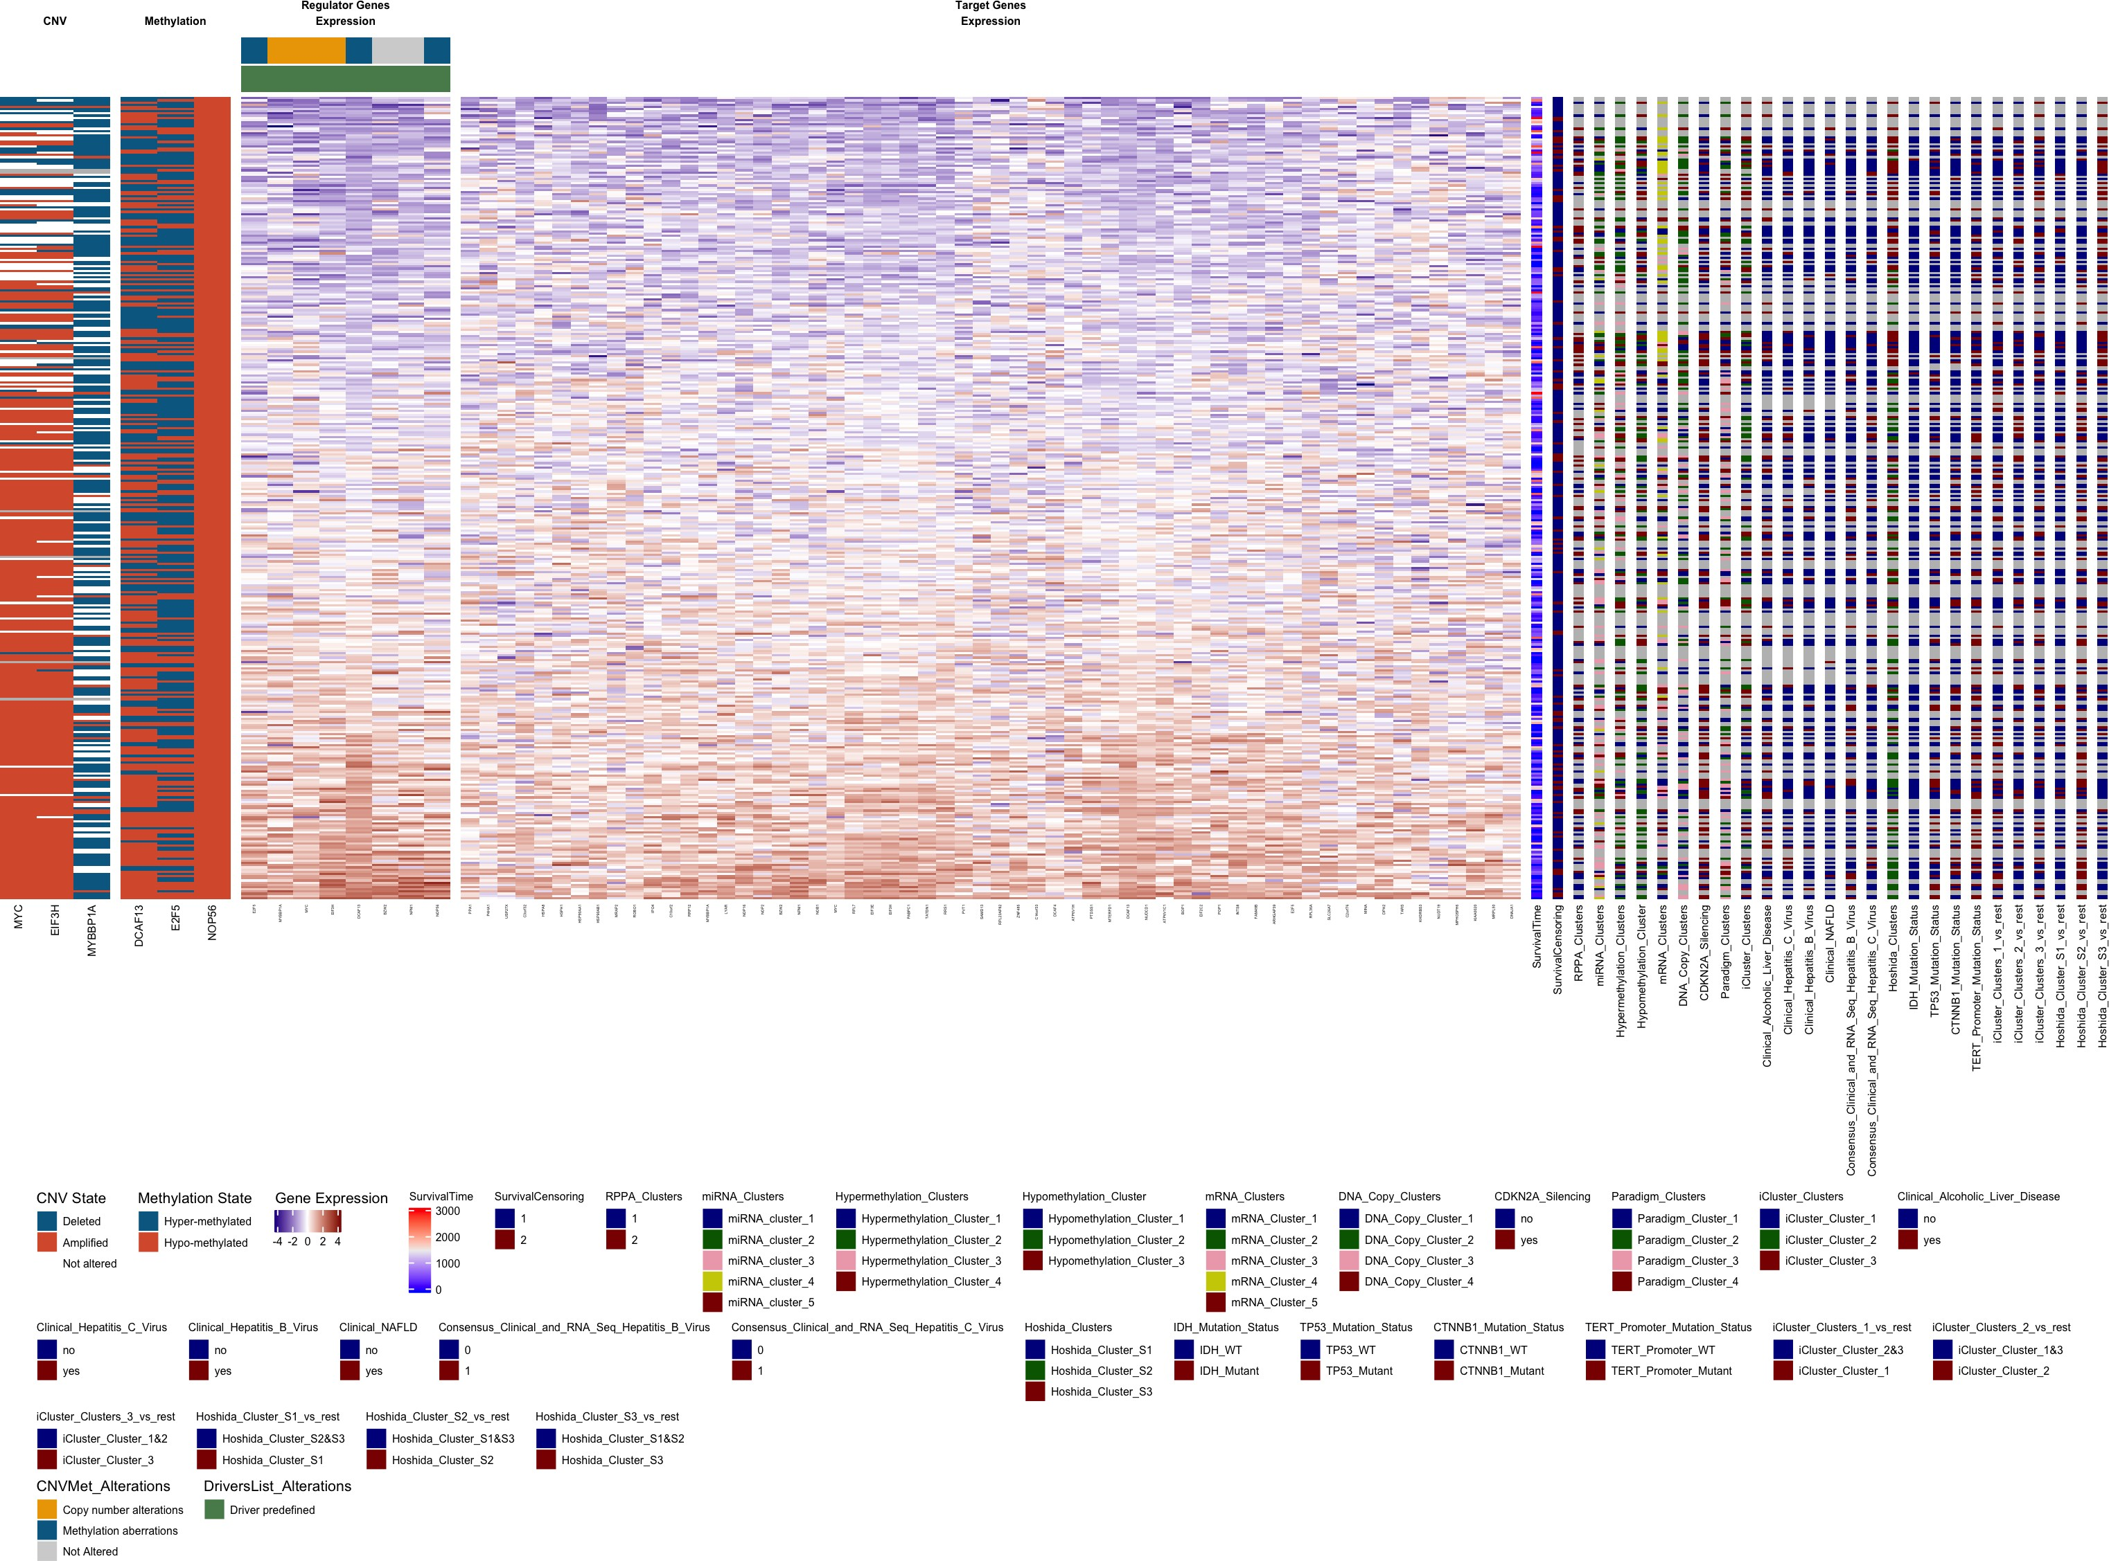
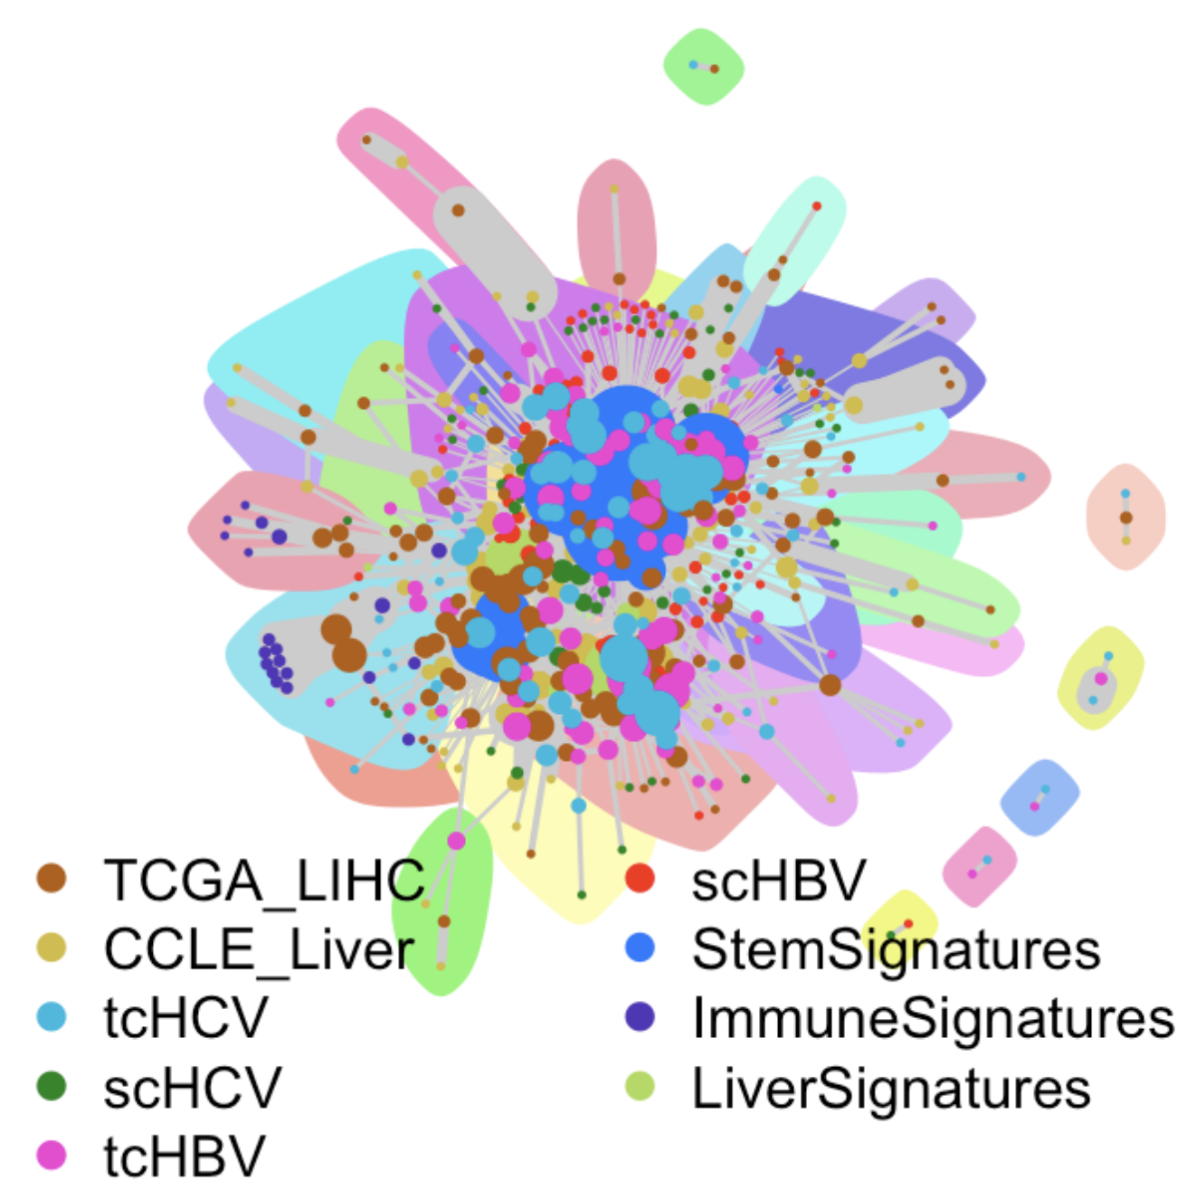
Drug discovery:
Chemoprevention of hepatitis C and B virus-induced hepatocellular carcinoma
Driver and drug discovery
for hepatitis C (HCV) and hepatitis B (HBV)
virus-induced hepatocellular carcinoma (HCC)
Pan-etiology of liver cancer
networks and subnetworks
of regulatory circuits
Notes:
And we learned networks and subnetworks of circuits across these data sets.

Slide 15
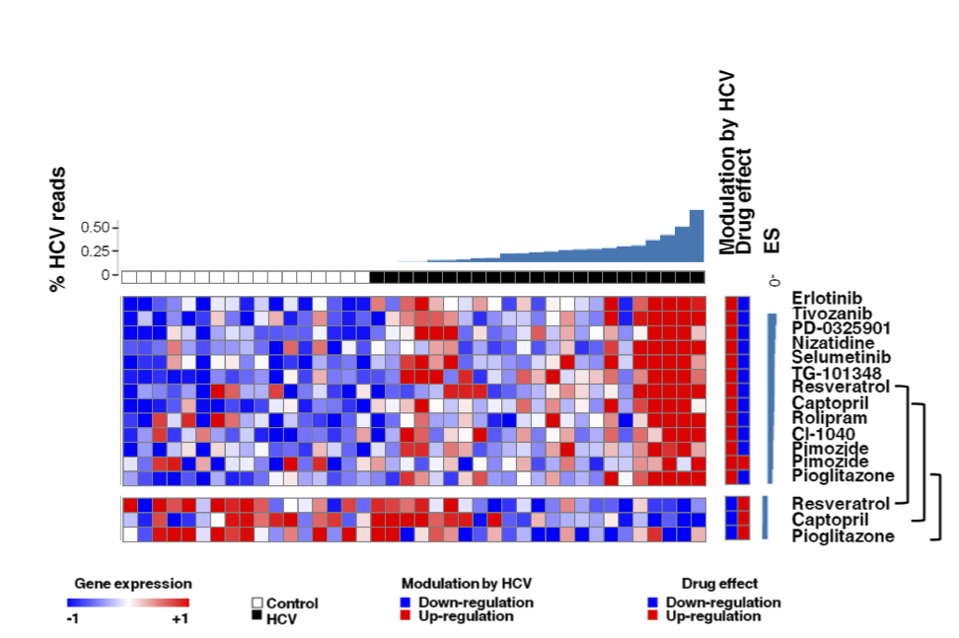
Drug discovery:
Chemoprevention of hepatitis C and B virus-induced hepatocellular carcinoma
Drug discovery
Chemical perturbations in cell lines
Predict which drugs can reverse disease-associated circuits
Alternative treatments with less severe adverse effects
Notes:
And then we used chemical perturbations in cell lines to predict which drug treatments can reverse disease-associated circuits.
In this study, our goal was to predict alternative treatments with less severe adverse effects compared to existing treatments.

Slide 16
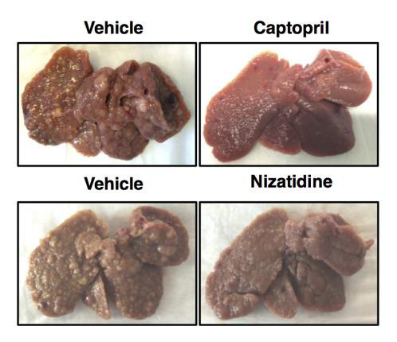
Drug discovery:
Chemoprevention of hepatitis C and B virus-induced hepatocellular carcinoma
Drug discovery
Drug validation
Chemical perturbations in cell lines
Predict which drugs can reverse disease-associated circuits
Alternative treatments with less severe adverse effects
Experimental validation of drugs in rat models
Two novel compounds attenuate HCC development
Safe and low-cost approach for chemoprevention of HCC?
Notes:
We experimentally validated our drug predictions in rat models, and we found that two novel compounds, Captopril and Nizatidine, can attenuate liver fibrosis and liver cancer development in rats.
In contrast with existing treatments whose adverse effects limit their clinical use as preventive medicine, these novel compounds potentially offer a safe and low-cost approach for chemoprevention of liver cancer.

Slide 17
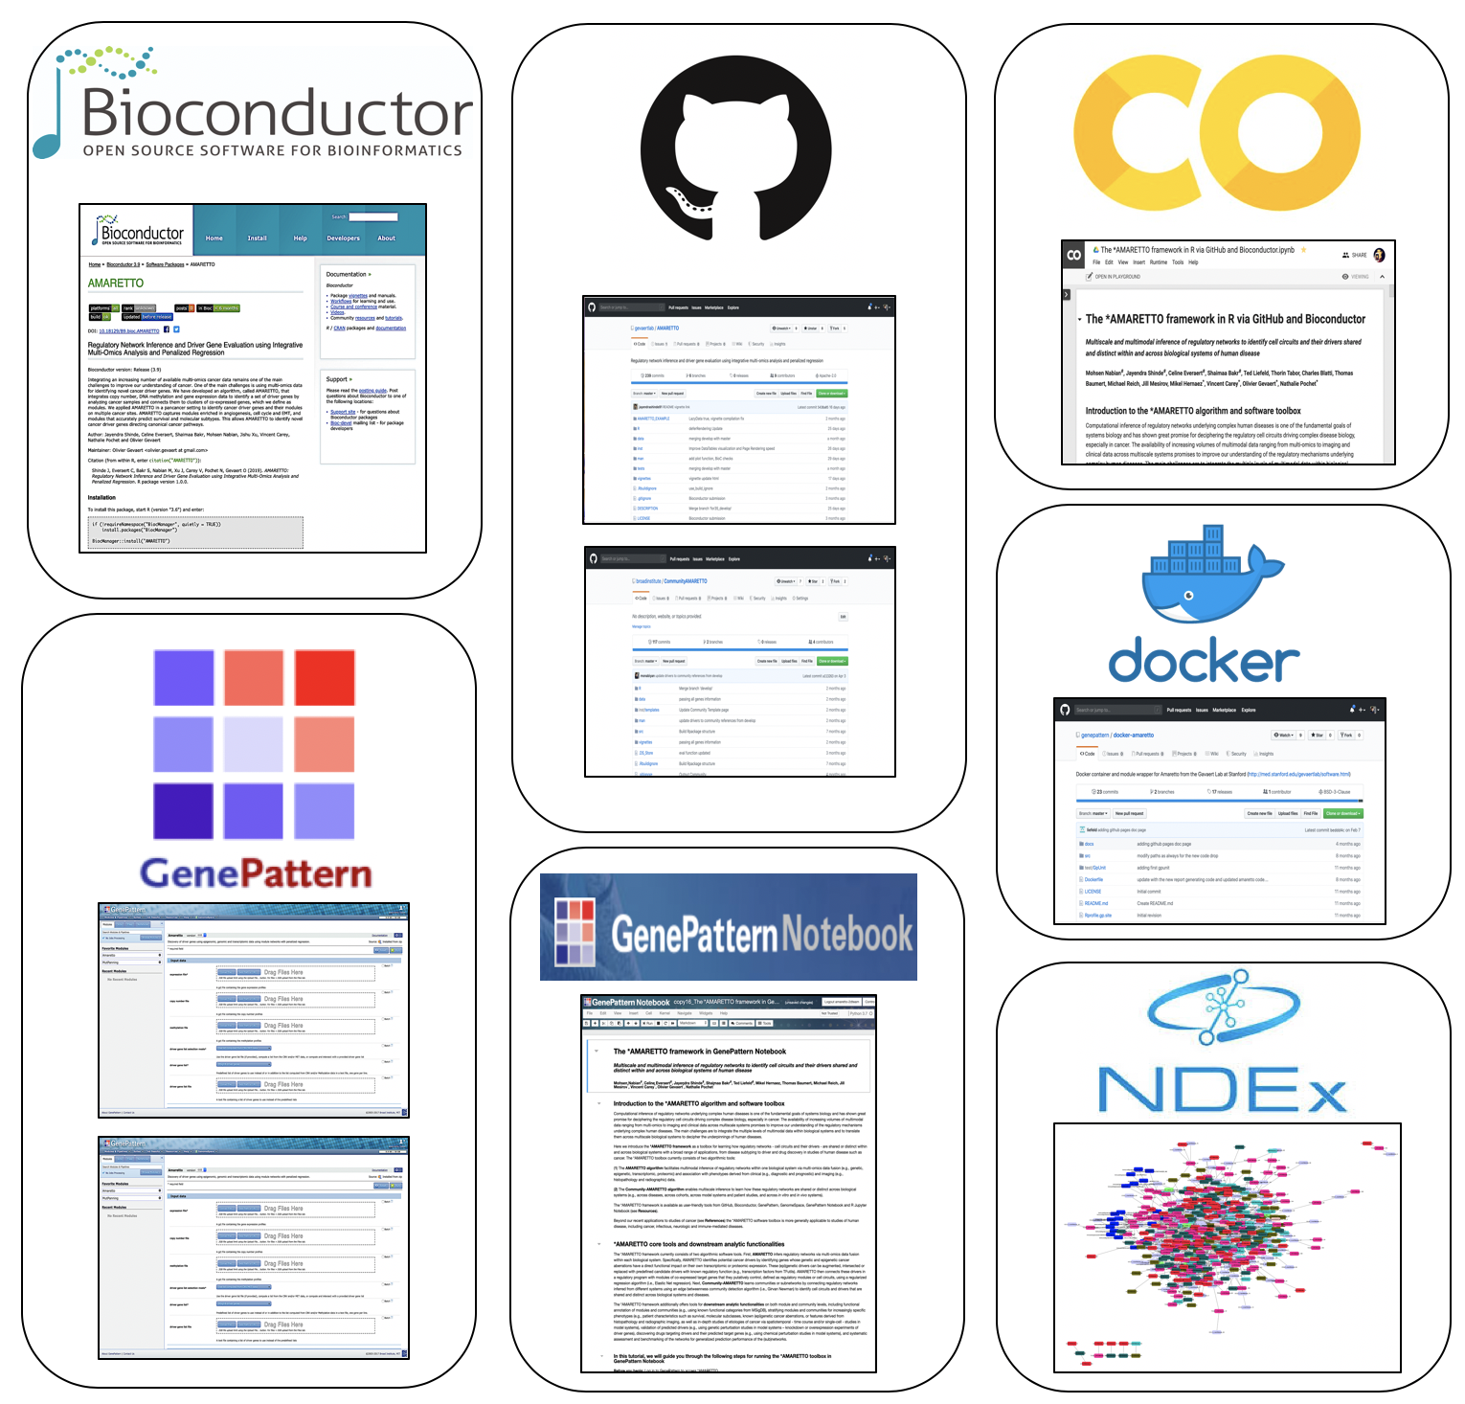
*AMARETTO source code, tools & notebooks
*AMARETTO is available via:
Bioconductor: https://bioconductor.org/packages/release/bioc/html/AMARETTO.html
GitHub
Jupyter Notebook: https://colab.research.google.com/drive/1JfnRoNgTVX_7VEGAAmjGjwP_yX2tdDxs
GenePattern
GenomeSpace
GenePattern Notebook
…
Automated reports with results:
Html reports: tables, heatmaps, graphs
Neo4j embedded Shiny reports: interactive querying of graphs and tables
Tools and resources: http://portals.broadinstitute.org/pochetlab/amaretto.html
Notes:
Our AMARETTO tools are available from various platforms, such as Bioconductor, GitHub, R Jupyter Notebook, GenePattern, GenomeSpace, and GenePattern Notebook.
Html reports with results in table format, and heatmap and graph visualizations, are generated in an automated way, and we’re now also developing neo4j embedded shiny reports that allow users to interactively query the results.

Slide 18
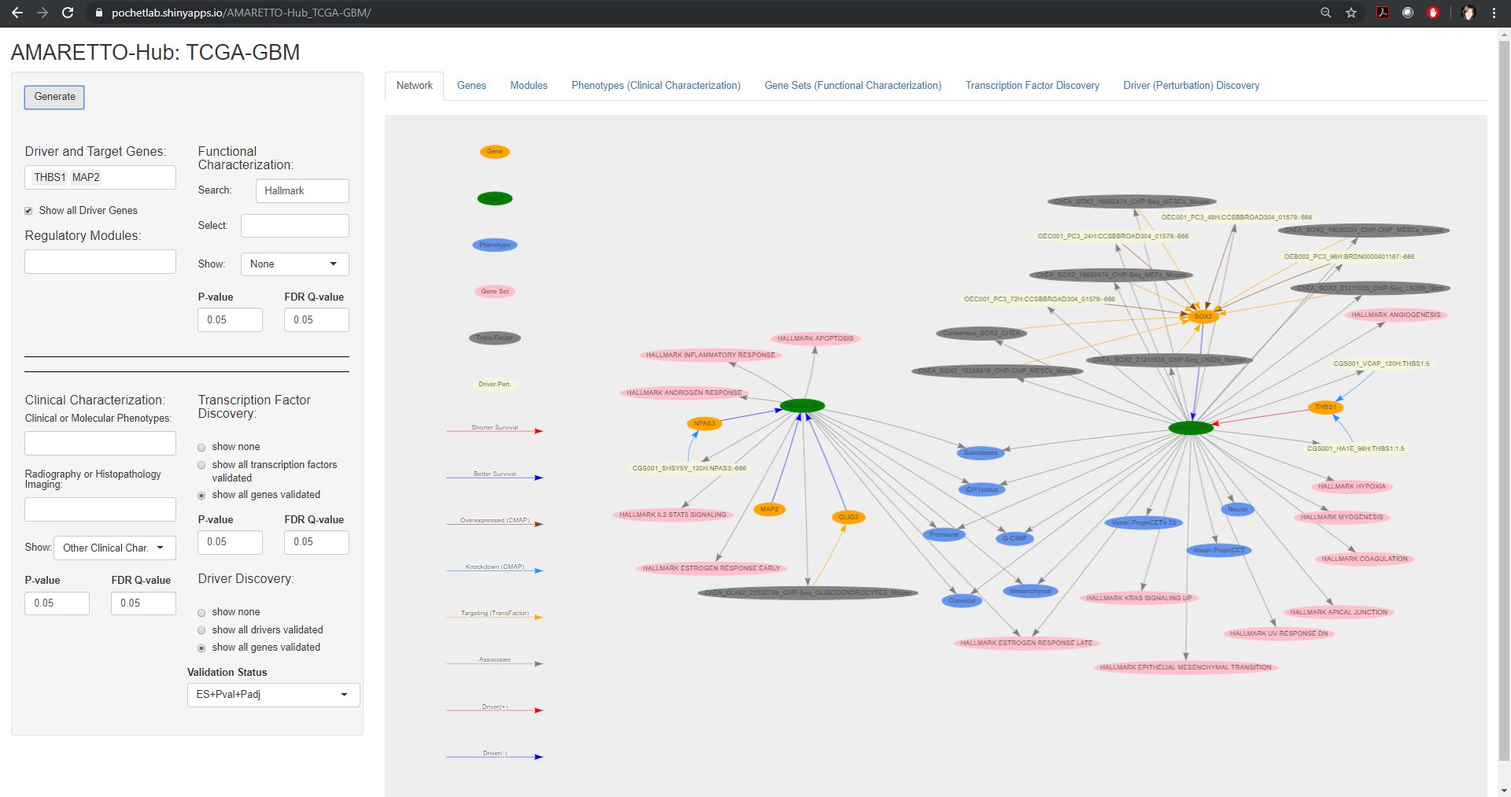
https://pochetlab.shinyapps.io/AMARETTO-Hub_TCGA-GBM/
Notes:
Here you see an initial prototype of our neo4j shiny reports, applied to the TCGA glioblastoma cohort.
In this graph visualization we use different types of nodes and edges to represent different biomedical entities and the relationships between them.
(For example, orange nodes are genes, green nodes are circuits, pink nodes are biological functions, blue nodes are clinical, molecular and imaging phenotypes, and grey and yellow nodes are experiments that validate transcription factors and drivers as regulators of their circuits.)

Slide 19
Use Cases: integrating multi-omics, clinical, imaging, and driver and drug perturbation data across model systems and patient studies of cancer
Notes:
We applied our tools to several use cases of cancer, and I don’t have time to go into the details, but I wanted to provide you with links to the html reports and R Jupyter Notebooks for running these use cases.

Slide 20
Use Cases: integrating multi-omics, clinical, imaging, and driver and drug perturbation data across model systems and patient studies of cancer
A study of hepatitis C and B virus-induced hepatocellular carcinoma (LIHC) with driver and drug discovery for chemoprevention across pan-etiologies of hepatocellular carcinoma, experimentally validated in rat models
A study of glioblastoma multiforme (GBM) and low-grade glioma (LGG) with driver discovery for diagnostic and prognostic molecular subclasses associated with radiography and histopathology imaging-derived features for imaging diagnostics
A pan-cancer study across twelve cancer sites with driver discovery of pan-cancer drivers of smoking-induced and ‘antiviral’ interferon-modulated innate immune response cancer
A pan-cancer study of squamous cell carcinoma (SCC) across five SCC cancer sites, in particular, lung (LUSC), head and neck (HNSC), esophageal (ESCA), cervical (CESC) and bladder (BLCA)
HTML Reports: http://portals.broadinstitute.org/pochetlab/demo/cAMARETTO_Liver_6DS/index.html
Jupyter Notebook: https://colab.research.google.com/drive/17GieTfYriTVlbKchl-OEb5nI_NA2vvjQ
Notes:
The first use case is on virus-induced liver cancer, that I explained before.

Slide 21
Use Cases: integrating multi-omics, clinical, imaging, and driver and drug perturbation data across model systems and patient studies of cancer
A study of hepatitis C and B virus-induced hepatocellular carcinoma (LIHC) with driver and drug discovery for chemoprevention across pan-etiologies of hepatocellular carcinoma, experimentally validated in rat models
A study of glioblastoma multiforme (GBM) and low-grade glioma (LGG) with driver discovery for diagnostic and prognostic molecular subclasses associated with radiography and histopathology imaging-derived features for imaging diagnostics
A pan-cancer study across twelve cancer sites with driver discovery of pan-cancer drivers of smoking-induced and ‘antiviral’ interferon-modulated innate immune response cancer
A pan-cancer study of squamous cell carcinoma (SCC) across five SCC cancer sites, in particular, lung (LUSC), head and neck (HNSC), esophageal (ESCA), cervical (CESC) and bladder (BLCA)
HTML Reports: http://portals.broadinstitute.org/pochetlab/demo/IcAMARETTO_Brain_3DS/index.html
Jupyter Notebook: https://colab.research.google.com/drive/14u1KZJ3Gf-9qjDycyBKzBiN5VzzOa2xU and https://colab.research.google.com/drive/11Q0GH6YHCoTZrDfHrUavixAi_f_qGBau
Neo4j Graph: https://pochetlab.shinyapps.io/AMARETTO-Hub_TCGA-GBM/
Notes:
The second use case is on glioblastoma and low-grade glioma, for imaging diagnostics.

Slide 22
Use Cases: integrating multi-omics, clinical, imaging, and driver and drug perturbation data across model systems and patient studies of cancer
A study of hepatitis C and B virus-induced hepatocellular carcinoma (LIHC) with driver and drug discovery for chemoprevention across pan-etiologies of hepatocellular carcinoma, experimentally validated in rat models
A study of glioblastoma multiforme (GBM) and low-grade glioma (LGG) with driver discovery for diagnostic and prognostic molecular subclasses associated with radiography and histopathology imaging-derived features for imaging diagnostics
A pan-cancer study across twelve cancer sites with driver discovery of pan-cancer drivers of smoking-induced and ‘antiviral’ interferon-modulated innate immune response cancer
A pan-cancer study of squamous cell carcinoma (SCC) across five SCC cancer sites, in particular, lung (LUSC), head and neck (HNSC), esophageal (ESCA), cervical (CESC) and bladder (BLCA)
Champion et al., EBioMedicine 2018
Notes:
The third use case is related to our pan-cancer study that we recently published in EBioMedicine.

Slide 23
Use Cases: integrating multi-omics, clinical, imaging, and driver and drug perturbation data across model systems and patient studies of cancer
A study of hepatitis C and B virus-induced hepatocellular carcinoma (LIHC) with driver and drug discovery for chemoprevention across pan-etiologies of hepatocellular carcinoma, experimentally validated in rat models
A study of glioblastoma multiforme (GBM) and low-grade glioma (LGG) with driver discovery for diagnostic and prognostic molecular subclasses associated with radiography and histopathology imaging-derived features for imaging diagnostics
A pan-cancer study across twelve cancer sites with driver discovery of pan-cancer drivers of smoking-induced and ‘antiviral’ interferon-modulated innate immune response cancer
A pan-cancer study of squamous cell carcinoma (SCC) across five SCC cancer sites, in particular, lung (LUSC), head and neck (HNSC), esophageal (ESCA), cervical (CESC) and bladder (BLCA)
HTML Reports: http://portals.broadinstitute.org/pochetlab/demo/cAMARETTO_PanCancer_5DS/index.html
Jupyter Notebook: https://colab.research.google.com/drive/17RwBxwWWnXJMRI_VZl-X-hztJTwvlFjl
Notes:
And that we here refined to a pan-squamous cell carcinoma study across 5 cancer sites.

Slide 24
Team: Lab & Collaborators
Pochet Lab (BWH/HMS/Broad)
Mohsen Nabian
Artur Manukyan
Celine Everaert
Rileen Sinha
Tom Croonenborghs
Carey Lab (BWH/HMS/Broad)
Vincent Carey
Regev Lab (MIT/Broad)
Aviv Regev
Brian Haas
Gevaert Lab (Stanford/Broad)
Olivier Gevaert
Jayendra Ravindra Shinde
Shaimaa Hesham Bakr
Andrew Gentles
Kevin Brennan
Magali Champion
Hernaez Lab (Illinois)
Mikel Hernaez
Mesirov Lab (UCSD/Broad)
Jill Mesirov
Michael Reich
Ted Liefeld
Thorin Tabor
Baumert Lab (Strasbourg)
Thomas Baumert
Joachim Lupberger
Eloi Verrier
Neurology (BWH/HMS)
Anna Krichevsky
Erik Uhlmann
Francisco Quintana
Jishu Xu
Nikolaos Patsopoulos
Vijay Kuchroo
Howard Weiner
Notes:
Finally, I want to thank all my collaborators and lab members on the *AMARETTO development team.

Slide 25
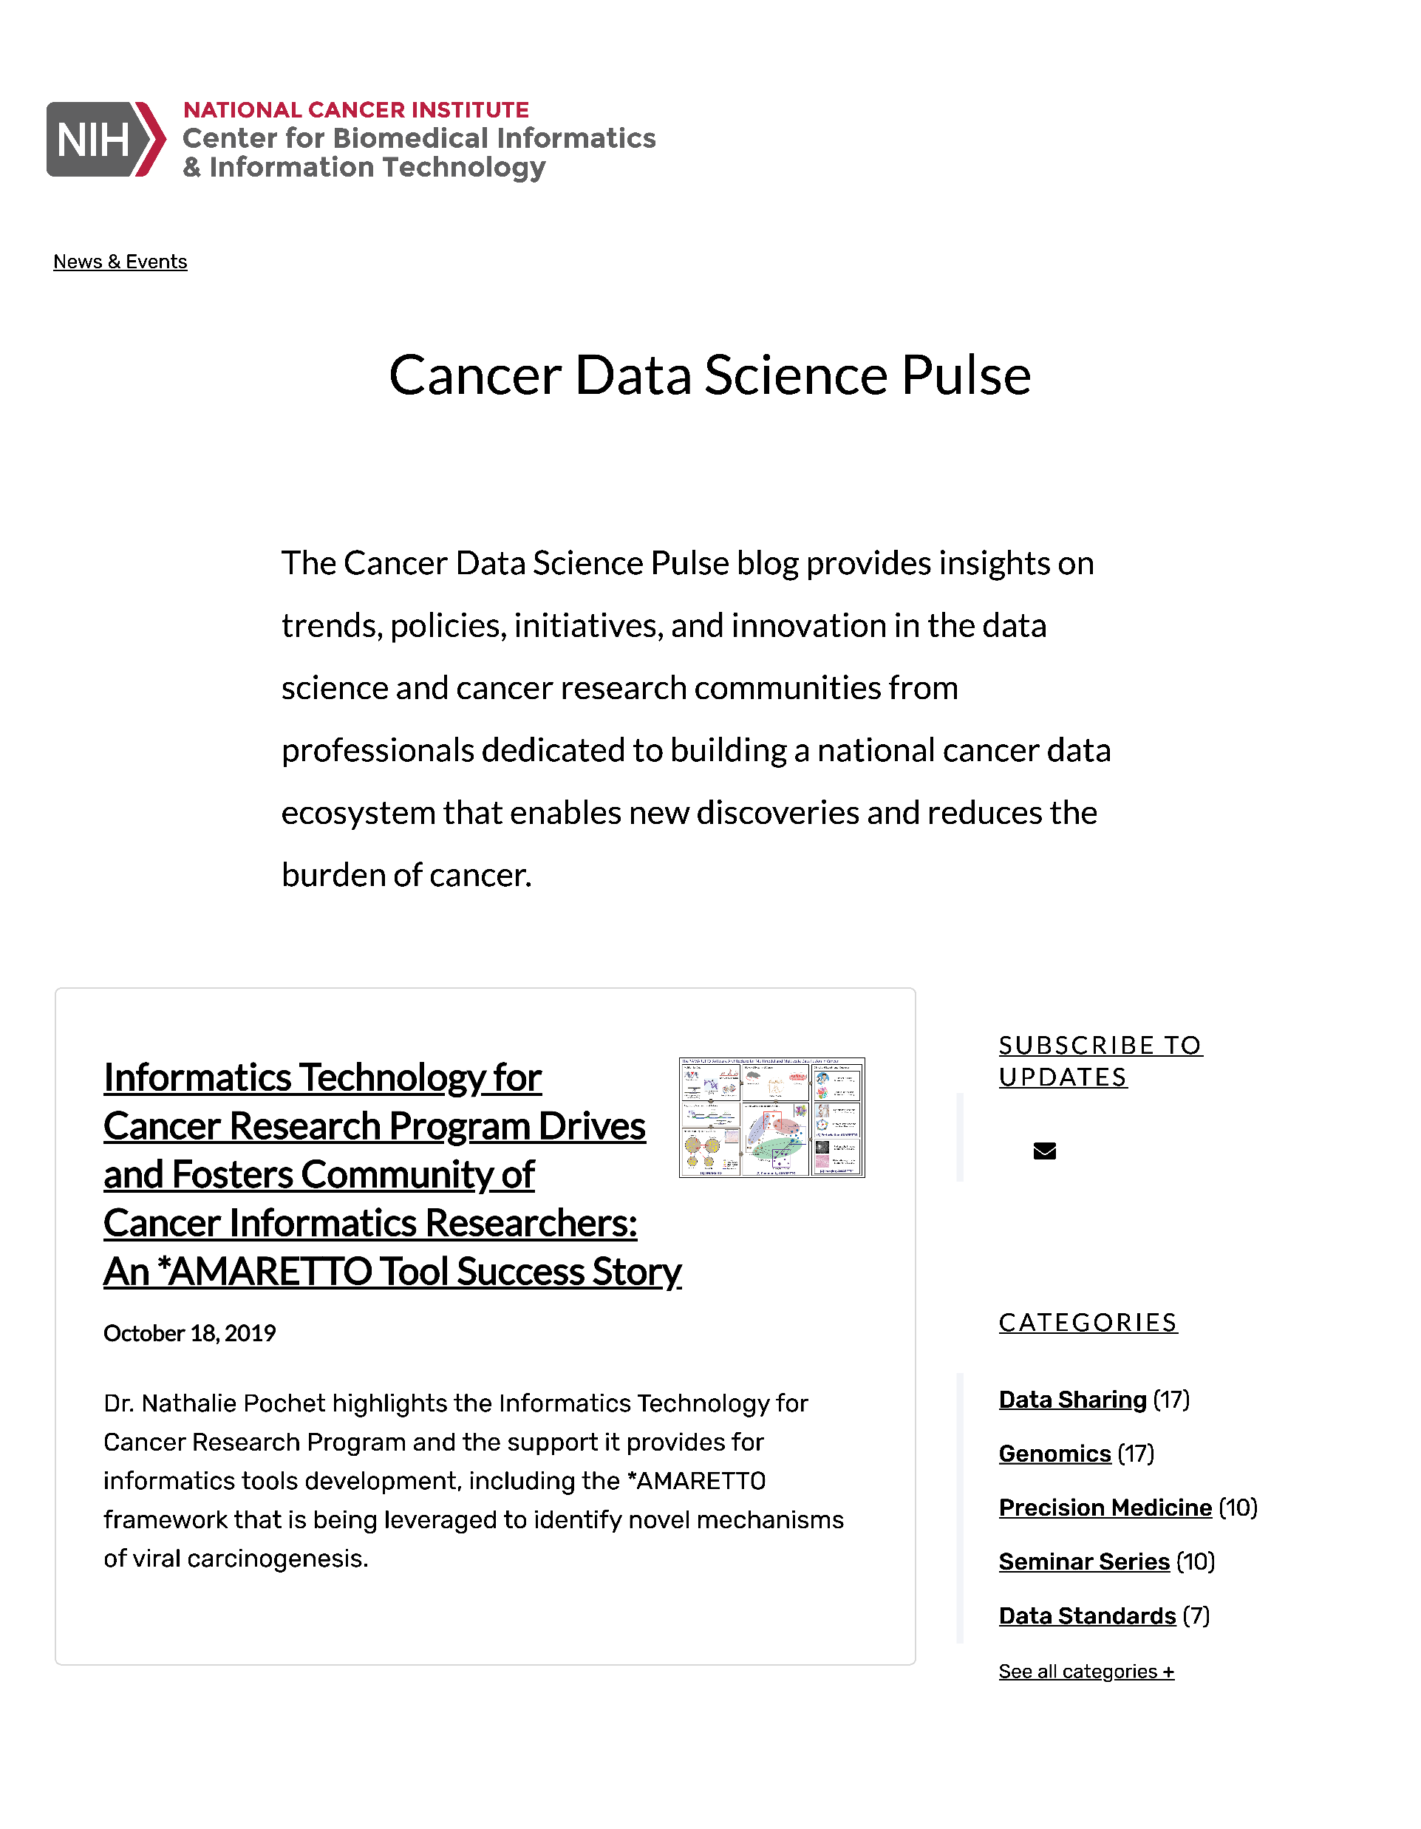
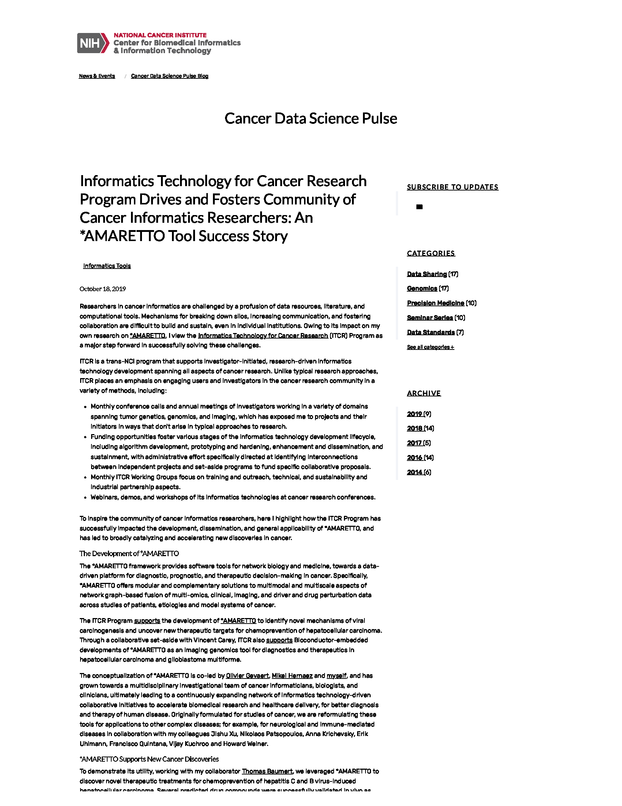
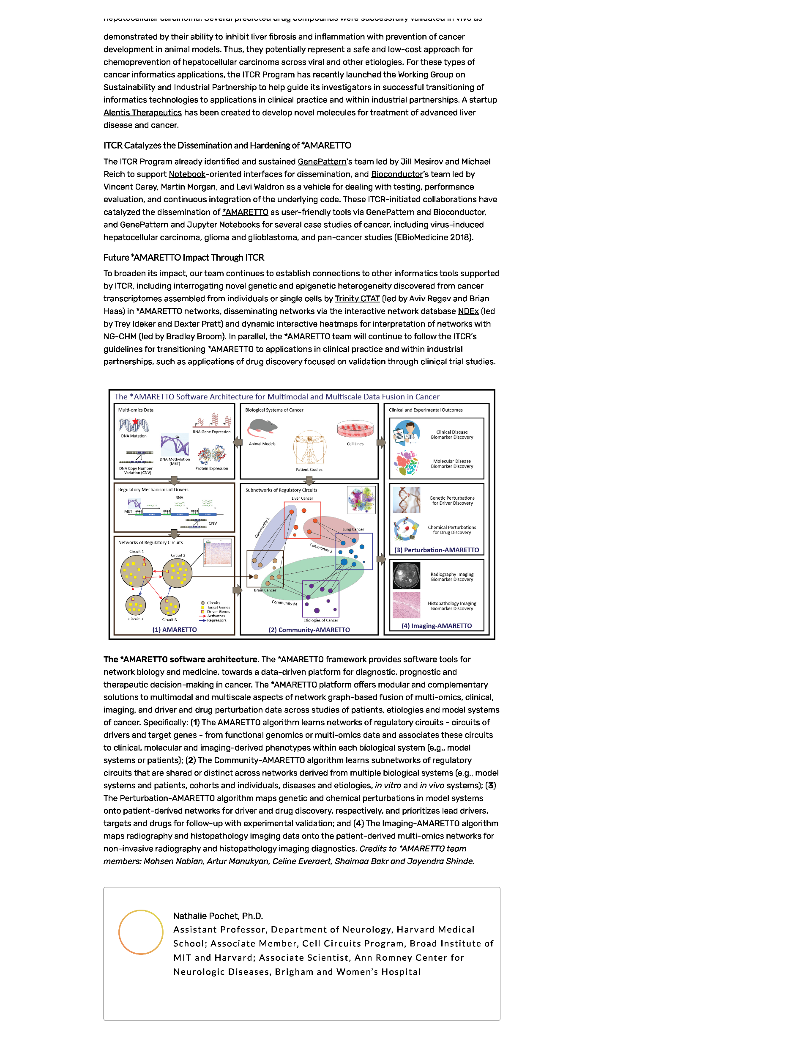
NIH NCI CBIIT ITCR Cancer Data Science Pulse Blog
https://datascience.cancer.gov/news-events/blog/informatics-technology-cancer-research-program-drives-and-fosters-community-cancer
Notes:
And if you want to know more about how we’re developing the *AMARETTO tools, I am also sharing a link to a blog that was published a few weeks ago.
Thank you for your attention!

